Slide 1
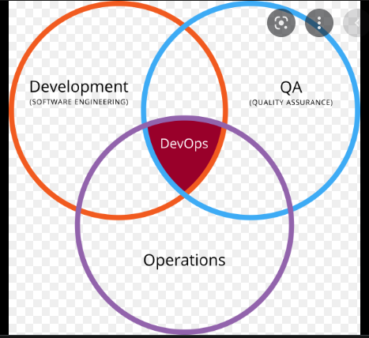
What is devOps
DevOps is the combination of cultural philosophies, practices, and tools that increases an organization's ability to deliver applications and services at high velocity: evolving and improving products at a faster pace than organizations using traditional software development and infrastructure management processes.

Slide 2

DevOps tools in market
. Infra creation -> aws,azure ,GCP
. Infra as code -> terraform,ARM,Bicep,awscli,azure cli
.version control-> git ,bit bucket ,azurerepos
.continues integration->Azure devops pipelines ,aws code pipelines ,Jenkins
.continuous deployment -> Azure devops pipelines ,aws deploy,Jenkins ,octopus deploy
.monitoring -> nagios ,ELK(elastic search ),newrelic,aws clode watch,azure monitor ,azure app insights

Slide 3
The tools that we are learning in this course
Infra : aws
Infra as code : terraform
version control-> GIT
continues integration-> Jenkins
continues deployment -> Jenkins
Monitor -> elk nagios nurolic

Slide 4

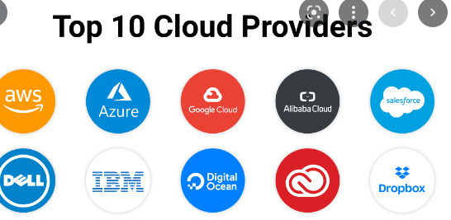
Different cloud providers in market

Slide 5
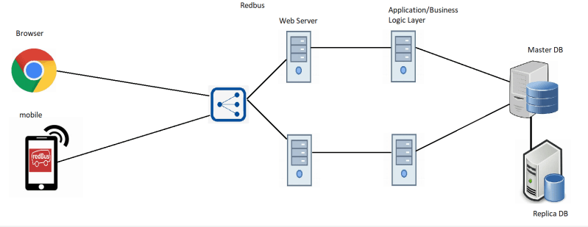
Traditional infra

Slide 6
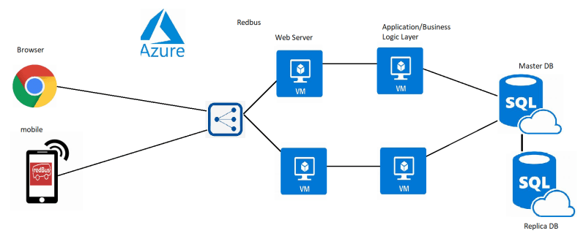
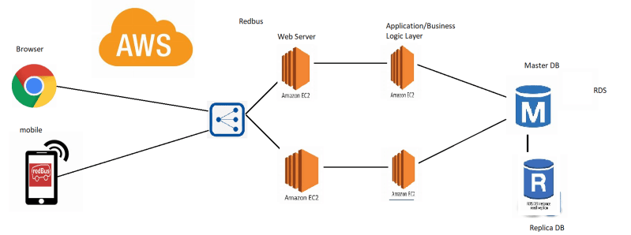
Infra in different clouds

Slide 7
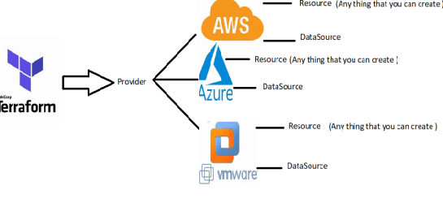
Infra as a code
we use terraform as infra provisioning tool in our course because in can create infra in any cloud provide
> it is very easy to write , because it has module pre defined in terraform registry
> it is free to use

